Slide 1
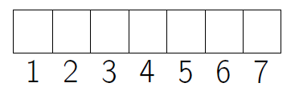
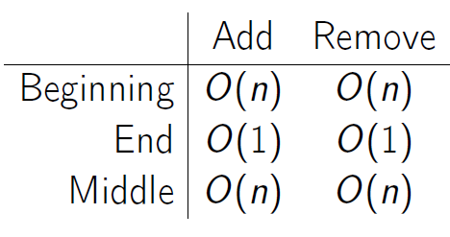
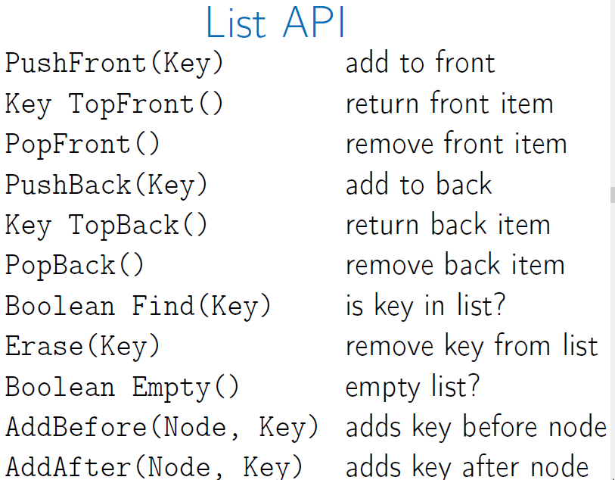
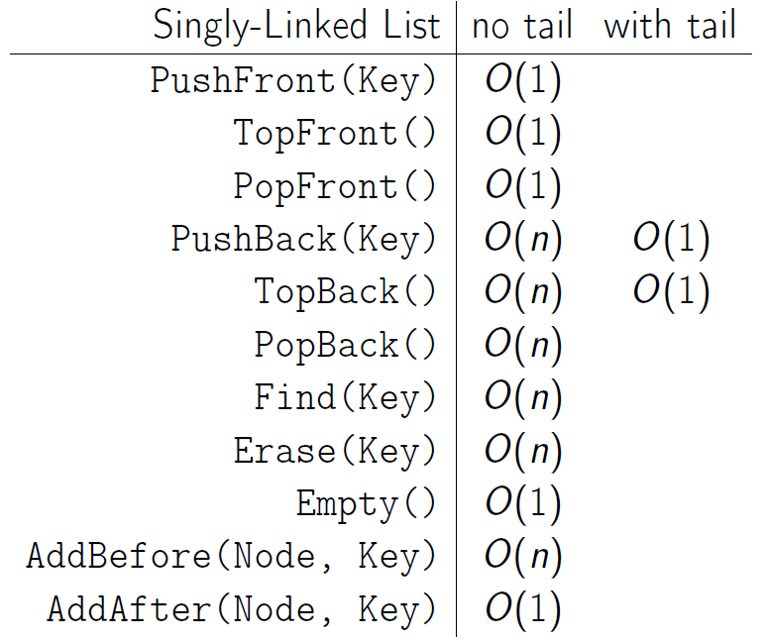
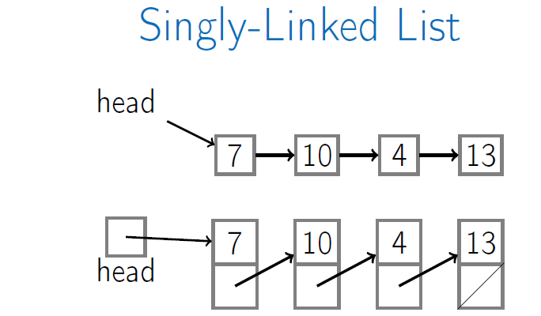
Data Structures
Week 1 Basic Data Structures
Arrays: contiguous area of memory consisting of equal-size elements indexed by contiguous integers.
Constant-time access: array_addr + element_size x (i – first_index).
For multi-dimensional arrays: array_addr + elem_size x ((row_index – first_row_index) x row_size + (column_index – first_column_index)).
Constant-time to add/remove at the end.
Linear-time to add/remove at an arbitrary location.
Singly-Linked Lists: Head + Node contains key and next pointer

Slide 2
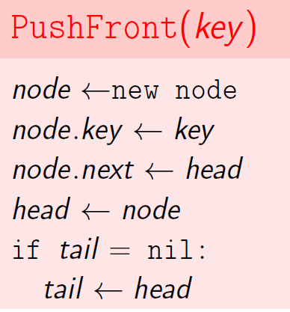
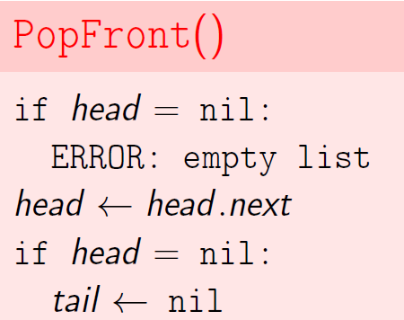
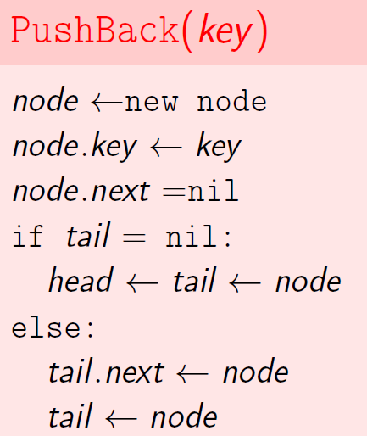
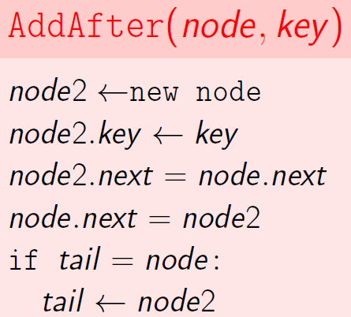
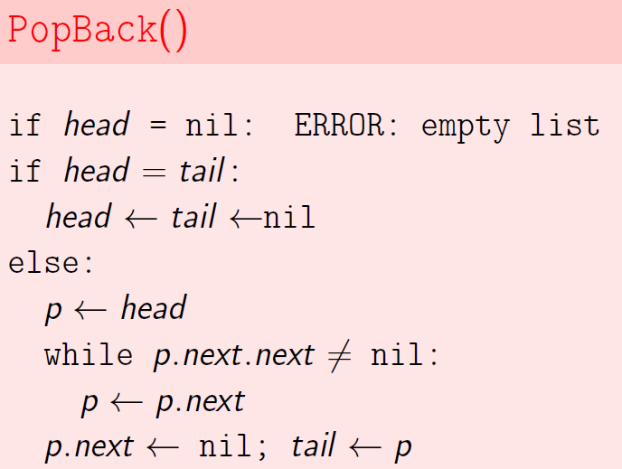
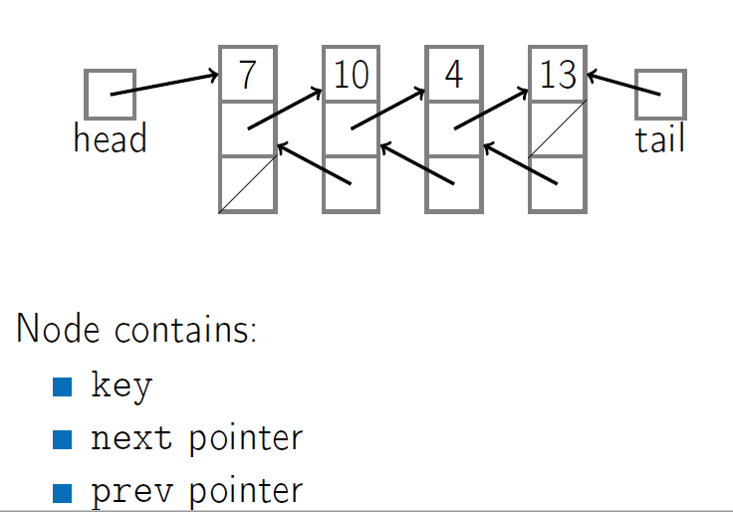
Doubly-Linked Lists:

Slide 3
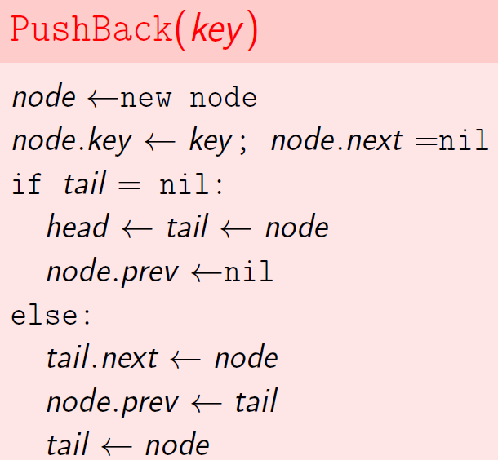
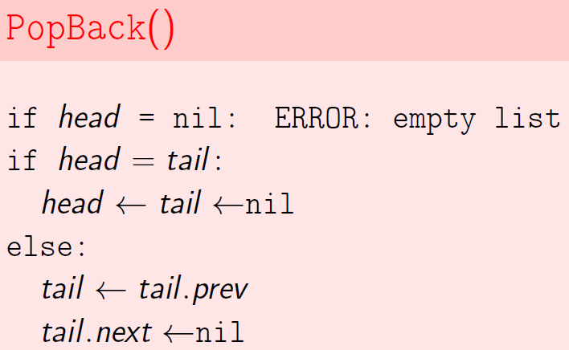
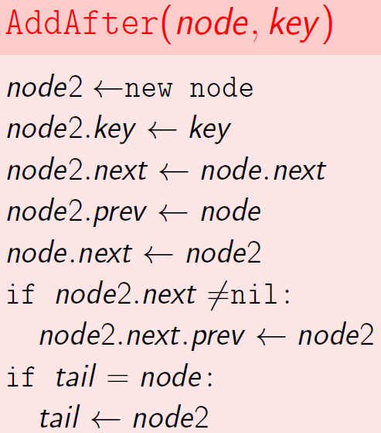
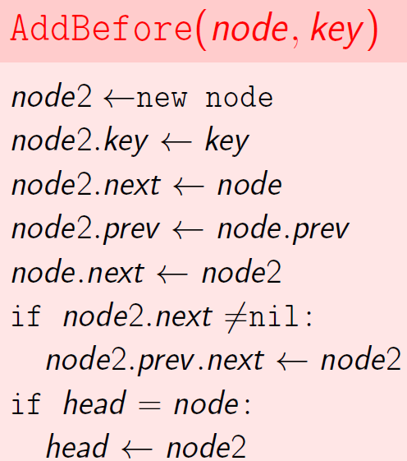
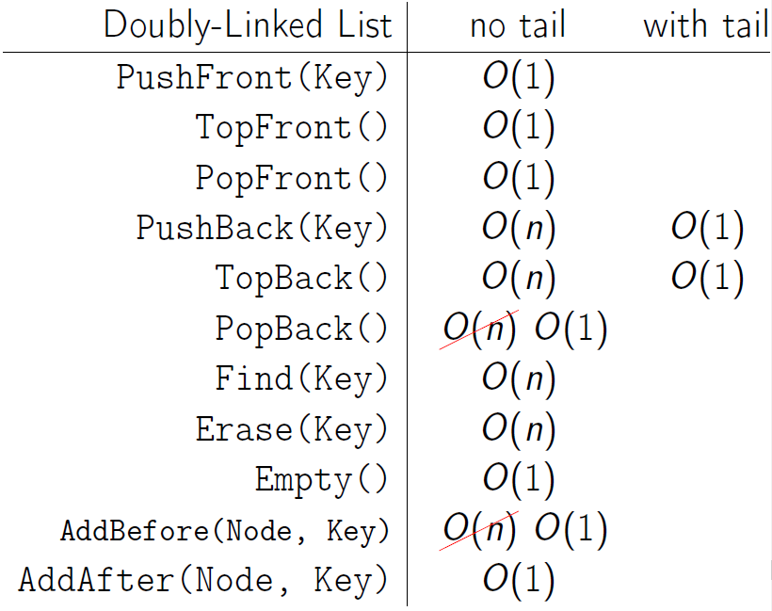
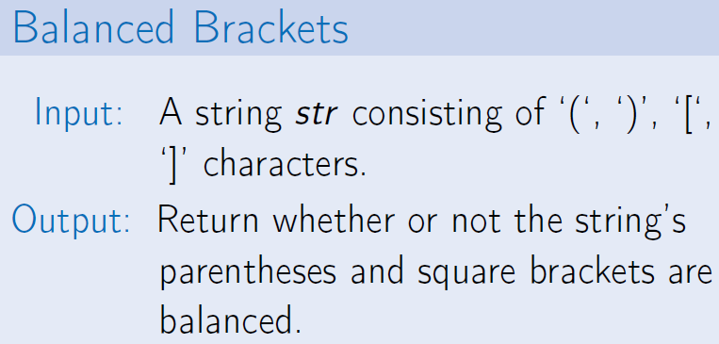
Stack: abstract data type with operations:
Push(Key): add key to collection
Key Top(): return most recently-added key
Key Pop(): remove and return most recently-added key
Boolean Empty(): are there any elements?

Slide 4
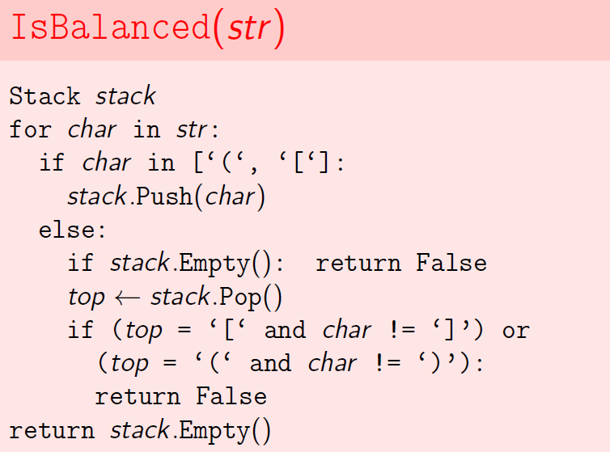
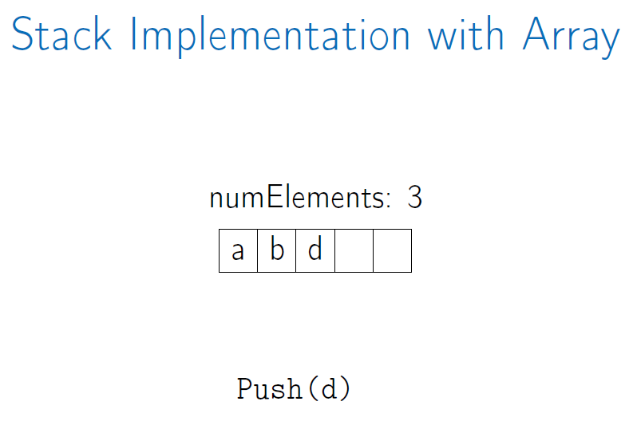
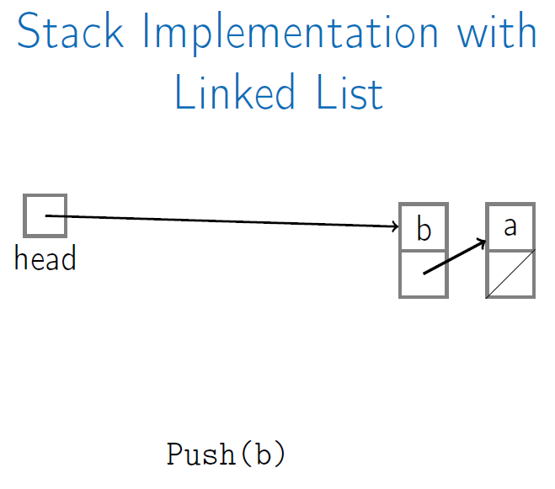
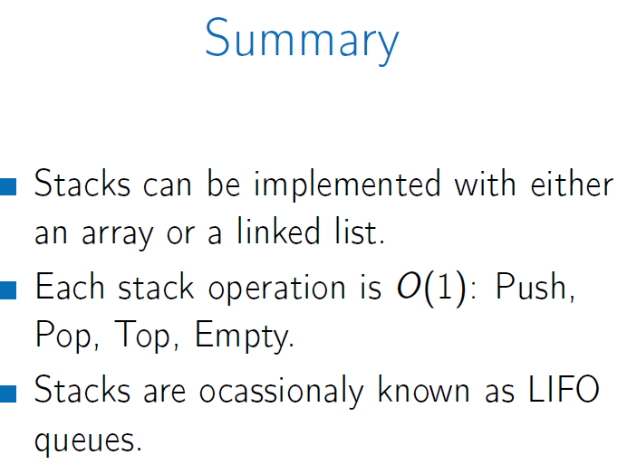
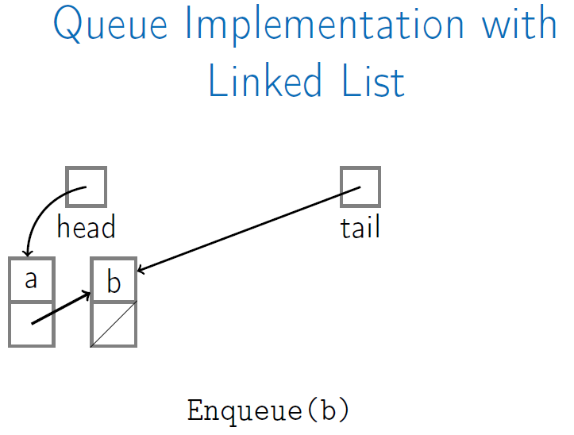
Queue: abstract data type with operations:
Enqueue(Key): add key to collection
Key Dequeue(): remove and return least recently-added key
Boolean Empty(): are there any elements?
FIFO: First-in, First-out

Slide 5
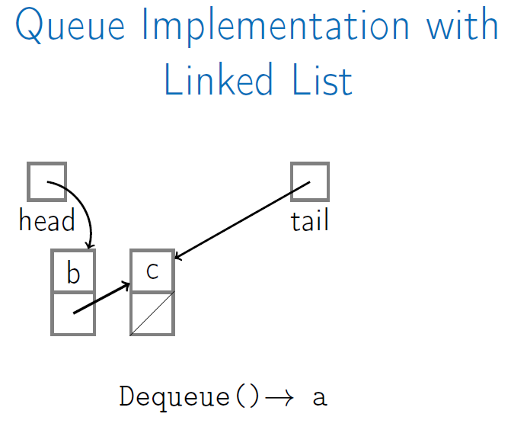
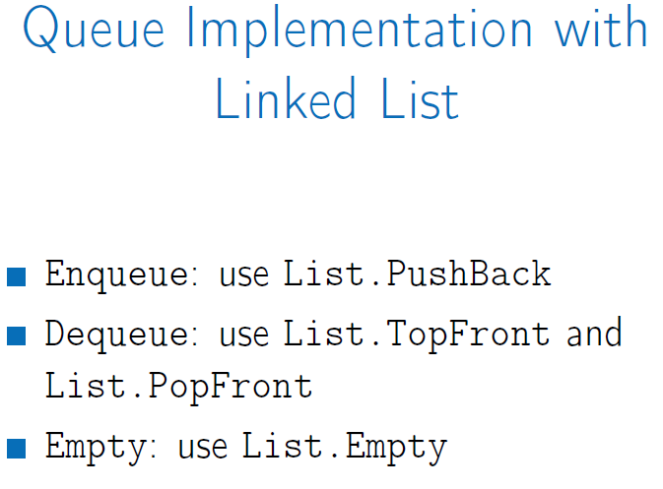
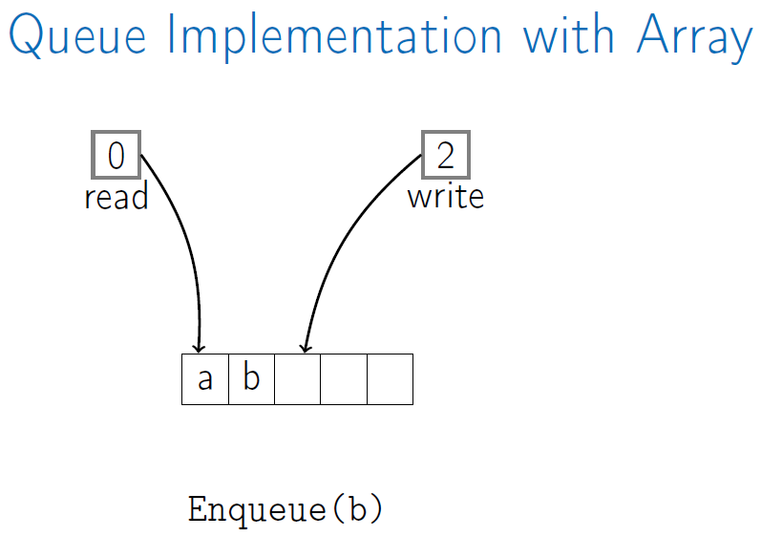
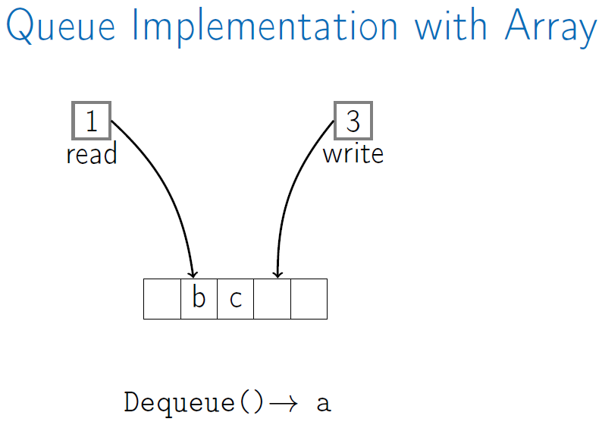
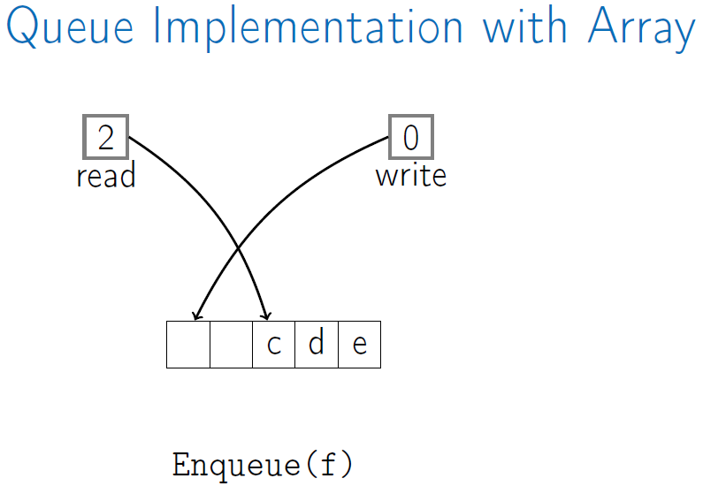

Slide 6
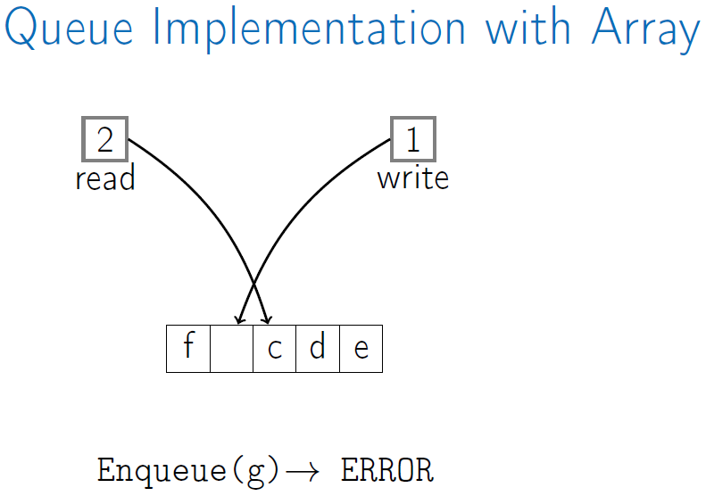
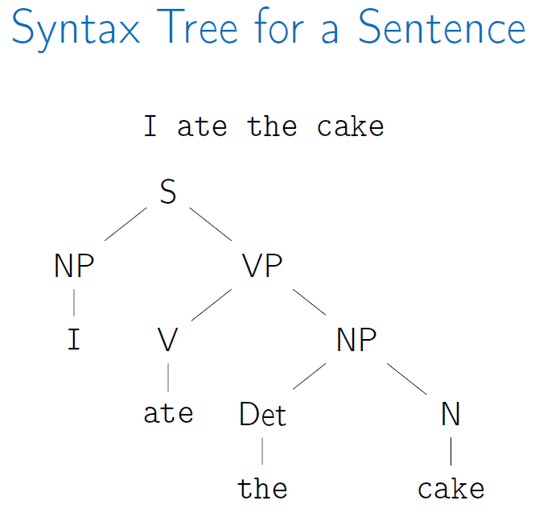
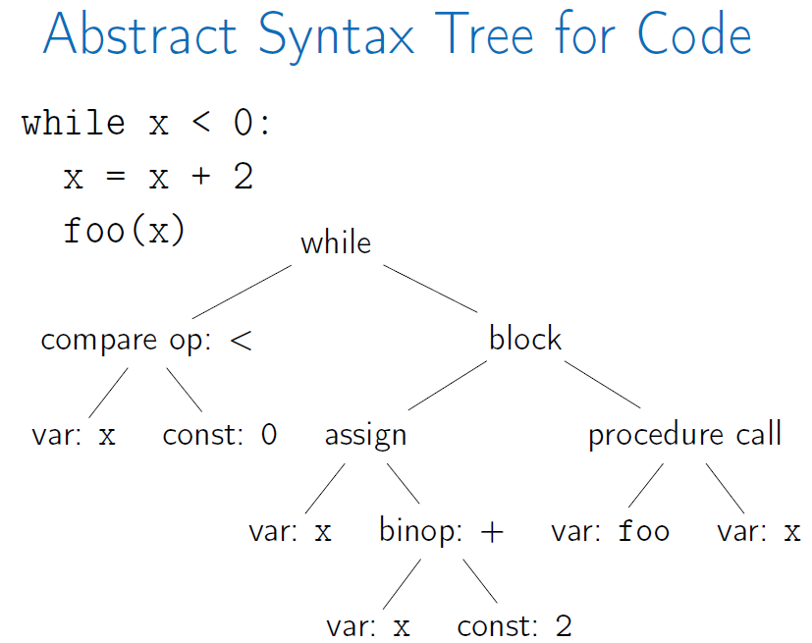
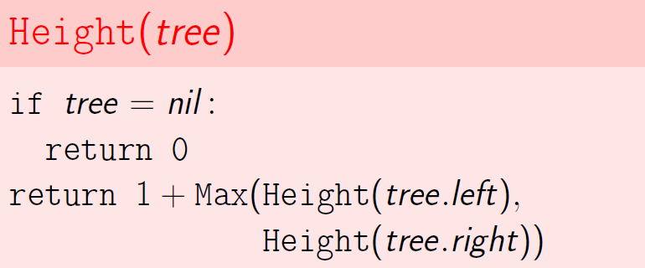
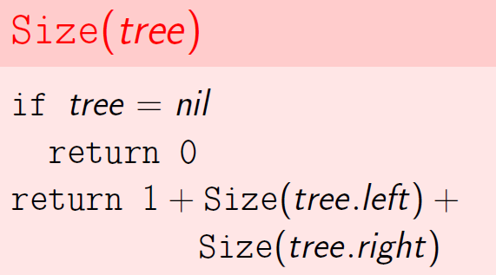
Summary:
Queue can be implemented with either a linked list (w tail pointer) or an array.
Each queue operation is O(1): Enqueue, Dequeue, Empty.
Tree:
Empty
A node with:
a key
Children: a list of children nodes
(optional) parent
Root: top node in the tree
Child: line down directly from parent
Ancestor: parent, or parent of parent
Descendant: child, or child of child
Sibling: sharing the same parent
Leaf: node with no children
Level: 1 + # edges btw root and node
Height: max depth of subtree node and farthest leaf
Binary tree nodes contains:
Key
Left
Right
(optional) parent
Walking a Tree:
Depth-first: we completely traverse one sub-tree before exploring a sibling sub-tree.
Breadth-first: we traverse all nodes at one level before progressing to the next level.

Slide 7
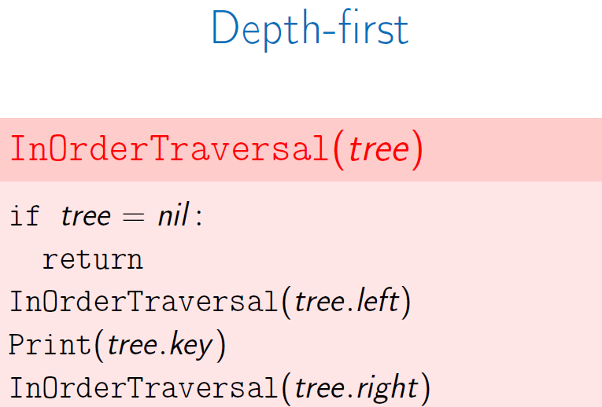
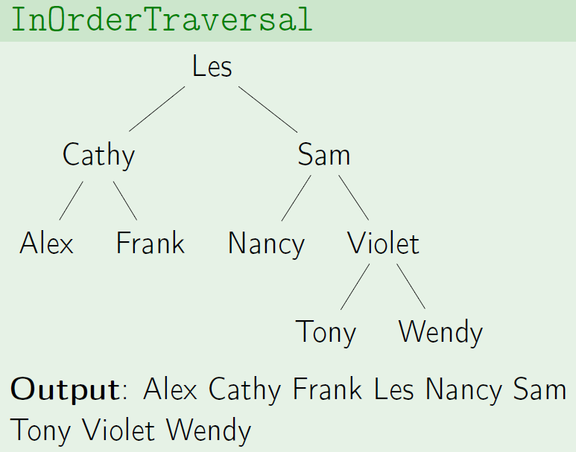
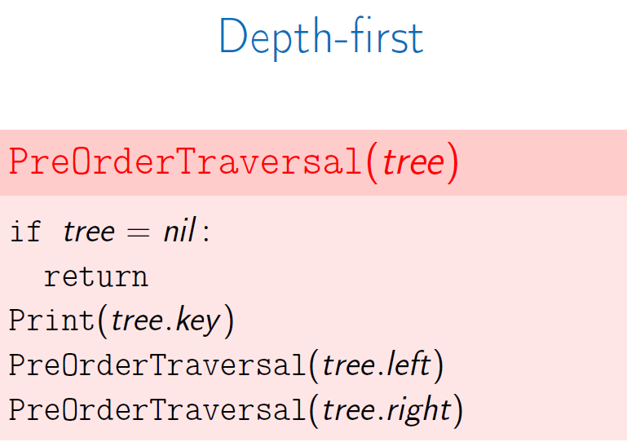
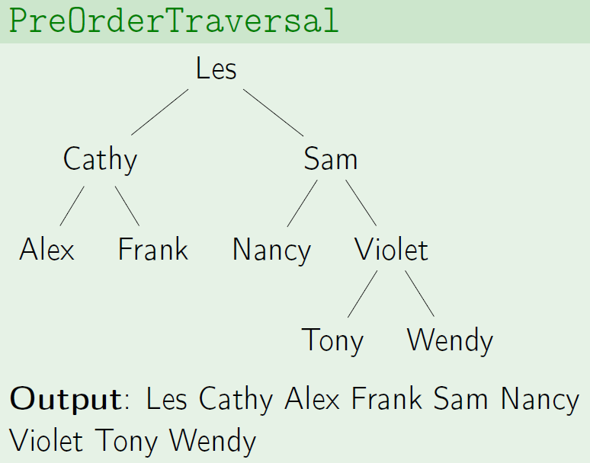

Slide 8
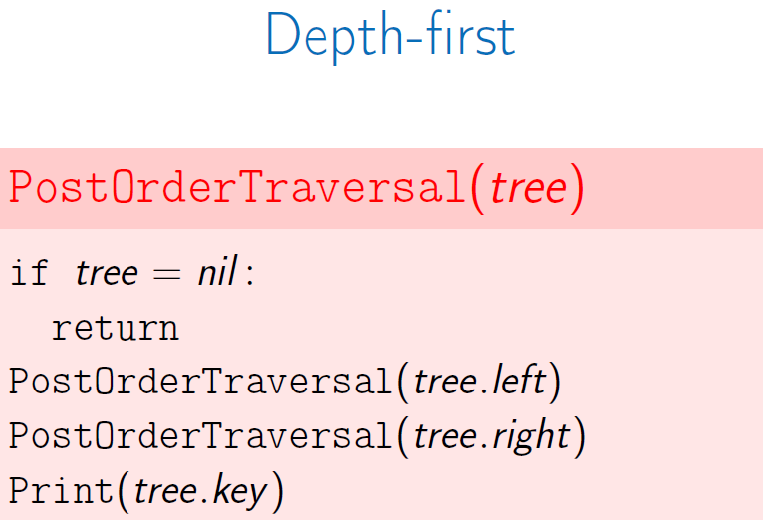
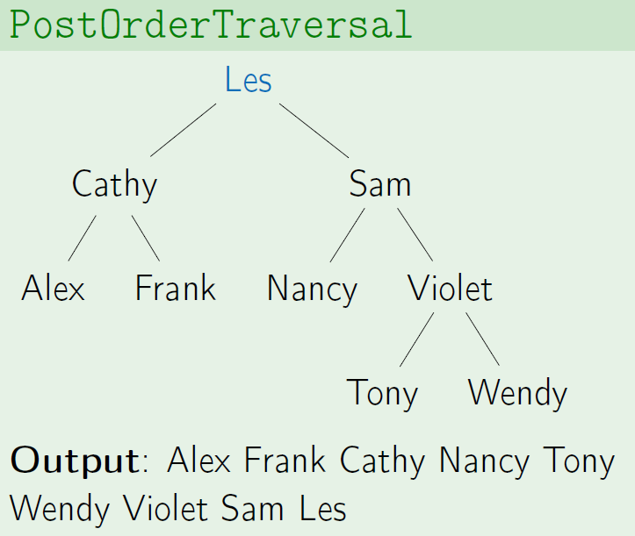
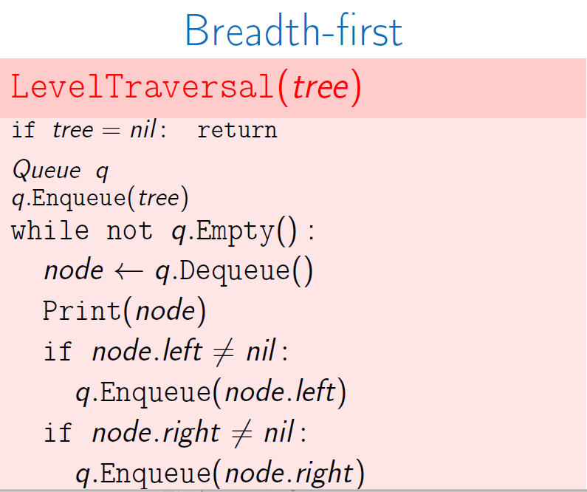
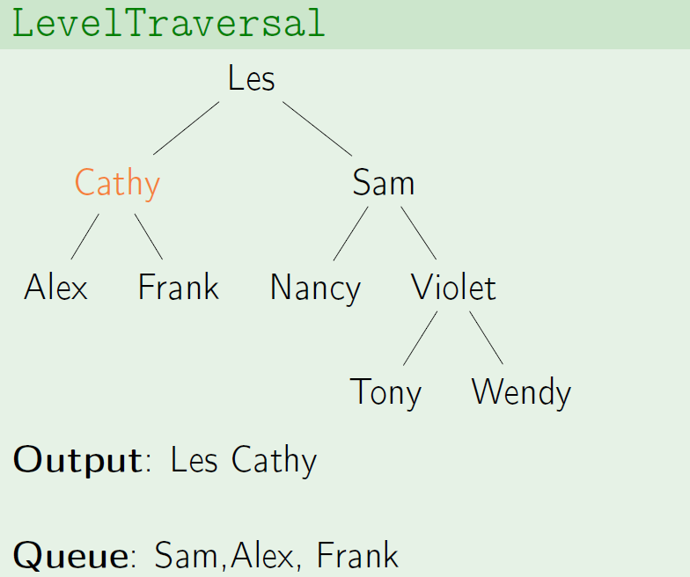
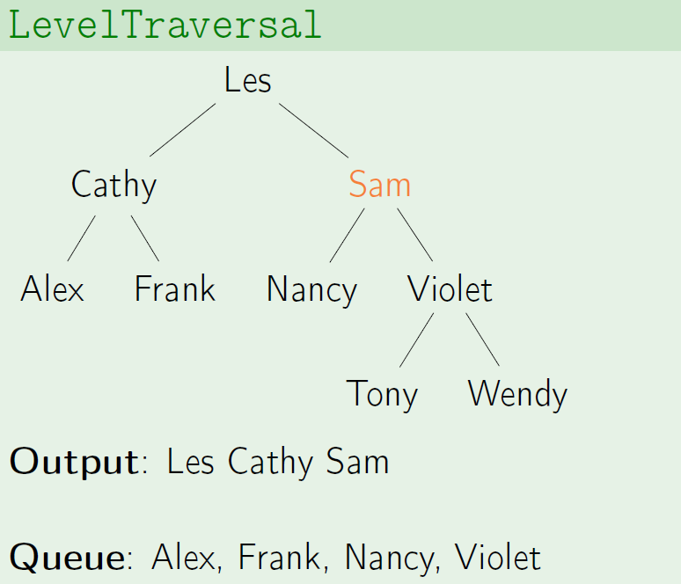
When working with a tree, recursive algorithms are common

Slide 9
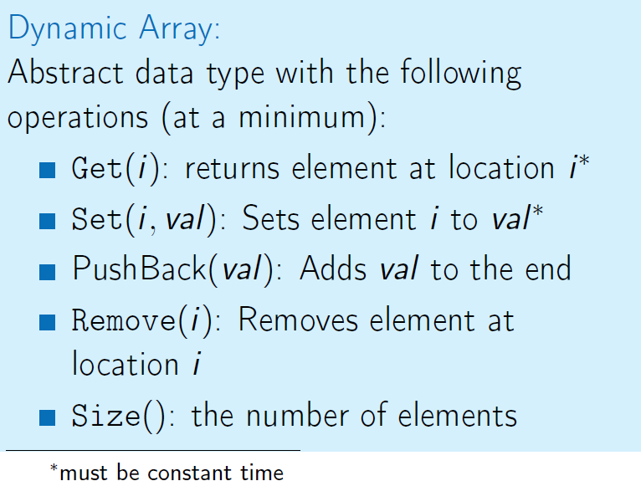
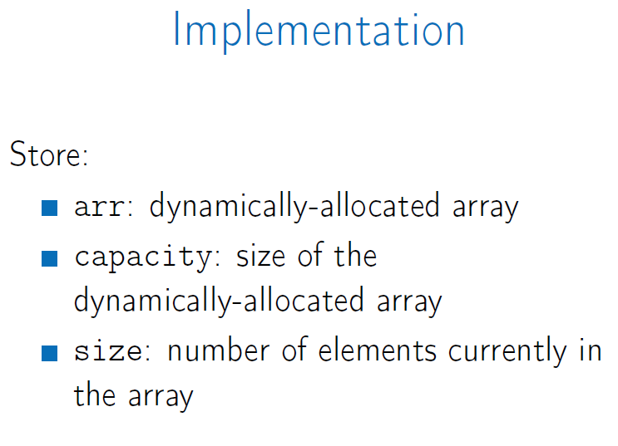
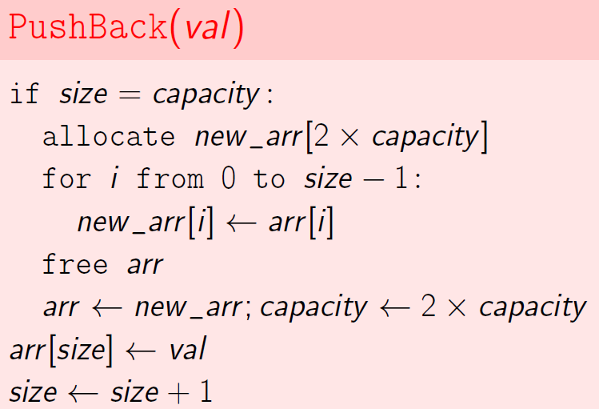
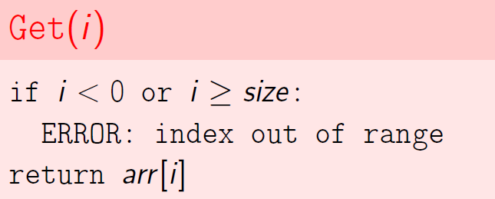
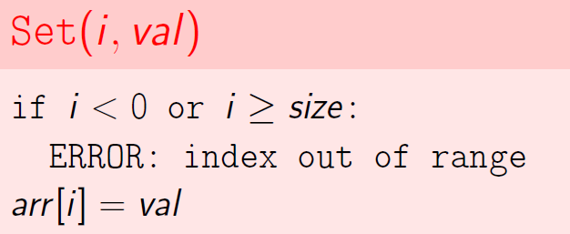
Week 2 Dynamic Arrays and Amortized Analysis
Dynamic Arrays:
Static arrays: int my_array[100]
Dynamically-allocated arrays: int *my_array = new int[size];
Dynamic arrays (resizable arrays): store a pointer to a dynamically allocated array, and replace it with a newly-allocated array as needed.

Slide 10
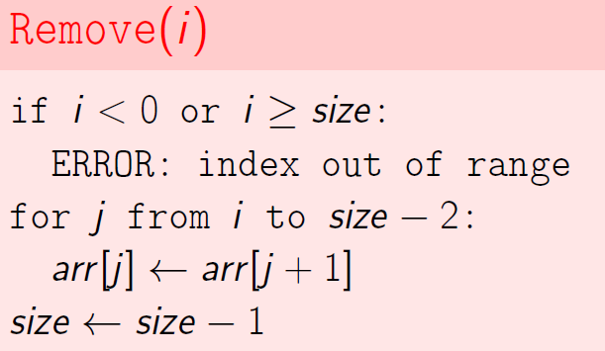
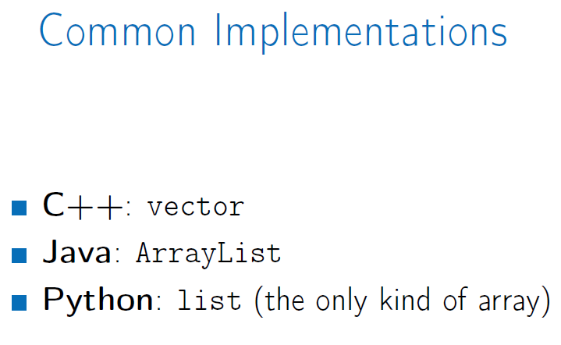
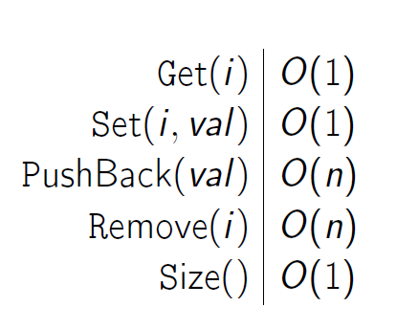
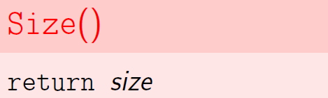



Amortized cost: given a sequence of n operations, the amortized cost is Cost(n operation)/n
Amortized Analysis ― Aggregate Method
Amortized Analysis ― Banker’s Method
O(1) amortized cost for each PushBack

Slide 11





Amortized Analysis ― Physicist’s Method

Slide 12






Week 3 Priority Queues and Disjoint Sets
Priority Queues: C++: priority_queue/Java: PriorityQueue/Python: heapq.
A queue includes opertions: PushBack(e) and PopFront().
A priority queue is a queue where each element is assigned a priority and elements come out in order by priority.

Slide 13



Binary Heaps: binary max-heap is a binary tree where the value of each node is at least the values of its children.
Basic operations:
GetMax: return the root value. O(1)
Insert: attach a new node to any leaf → shift up & swap problematic node with parent until property is satisfied. O(Height)
ExtractMax: replace the root w any leaf → shift down problematic node → swap with larger child. O(Height)
ChangePriority: change the priority and shift up or down. O(Height)
Remove: Change the priority of element to INF → shift up and then call ExtraMax(). O(Height)
To keep tree shallow, binary tree is complete if all its levels are filled except possible last one which is filled from left to right.
A complete binary tree with n nodes has height at most O(logn)
Insert the element as a leaf in the leftmost vacant position in the last level and let it shift up.
For ExtraMax(), replace the root by the last leaf and let it shift down

Slide 14









Heap Sort
O(nlogn)
Not in-place: use additional space to store the priority queue
Turn an array into a heap for In-place heap sort algorithm
O(nlogn)

Slide 15







Disjoint Sets:

Slide 16






Linked list for Union:
Represent a set as a linked list, use the list tail as ID of the set and running time is O(1).
Efficient Implementations using Tree and Union by Rank
Represent each set as a rooted tree and ID of a set is the root of the tree.
Use array parent[1…n]: parent[i] is the parent of i or i if it is the root.

Slide 17






Union(2,4)
Union(2,5)

Slide 18




For any node i, rank[i] = the height of the tree rooted at i.
The height of any tree is at most log₂x.
Any tree of height k has at least 2^{k} nodes.
Union and Find work in time O(logn)
Union(3,1)
Union(2,3)
Union(2,6)
Path Compression
The path of Find(6) from 6 to the root
Keep the path information

Slide 19








Week 4 Hash Tables

Slide 20






Direct Addressing: Need 2³² memory even for few IPs. In general, O(N) memory, N=S
O(1)
List-based Mapping: Store only active IPs, in a list, only last occurrence of each IP and keep order of occurrence.

Slide 21






Hash Functions and Hash Table: direct addressing with O(m) memory and want small cardinality m
Chaining is a technique to implement a hash table.
Memory consumption is O(n+m)
Operations work in time O(c+1)

Slide 22







Hash Table: an implementation of a set or a map using hashing. ( C++: unordered_set and unordered_map) (Python: set and dict) (Java: HashSet and HashMap)

Slide 23




Good Hash Function: deterministic/fast to compute/distribute keys into different cells/few collisions
Need 2 Maps:
Phone # → Name and Name → Phone #
Implement Maps as hash table
Direct Addressing:
Int(123-45-67) = 1234567
Create array Name of size 10^{L} where L is max phone # length
Store phone number P in Name[int(P)]
If no contact with P, Name[int(P)] = N/A
Operations in O(1) and Memory O(10^{L})
Chaining:
Select hash function h with m
Create array Name of size m
Chain Name[h(int(P))]
n phone #
m cardinality of hash function
c length of longest chain
O(n+m) memory is used
Load factor n/m
Operations in O)c+1)

Slide 24







Universal Family:
Hash Integers
Dynamic Hash Tables: Resize the hash table when α becomes too large

Slide 25






Hash String: Phone # → Name

Slide 26





String Search:
Naïve Algorithm
Running time O(TP)

Slide 27






Rabin-Karp’s Algorithm: use hashing to quickly compare P with substrings of T

Slide 28







Slide 29






Distributed Hash Tables
For New File Upload
Problem of Collisions and O(N) compare

Slide 30







Slide 31




Week 5 Binary Search Trees 1
 | Hash Table | Array | Sorted Array | Linked List
RangeSearch | Impossible | O(n) | O(log(n)) | O(n)
NearestNeighbors | Impossible | O(n) | O(log(n)) | O(n)
Insert | O(1) | O(1) | O(n) | O(1)
Delete | O(1) | O(1) | O(n) | O(1)
Search Trees

Slide 32








Missing Key
O(Depth)

Slide 33











Slide 34






Balanced Trees
Problem: insert and delete can destroy the balance.
Rotate to rebalance the tree
AVL Trees

Slide 35






Need ensure that children have nearly the same height
Update the tree can destroy this property
Height stay the same except on the insertion path
Need a new insertion algorithm involves rebalancing to maintain AVL property
If maintain AVL tree property, perform the operation in O(log(n))

Slide 36







Slide 37





All operations are in O(log(n))
Split and Merge
New Operations:
Merge: combines two binary search tree into a single one.
Split: breaks one binary search tree into two.

Slide 38







This merge doesn’t preserve balance properties, if height of R1 >> height of R2

Slide 39







Wiki: https://en.wikipedia.org/wiki/AVL_tree
Visualization: https://www.cs.usfca.edu/~galles/visualization/AVLtree.html
Week 6 Binary Search Trees 2
Order Statistics

Slide 40






Color Flip
O(h)
Opposite Color

Slide 41









Splay Trees
Idea: bring the query node to root
bring common nodes near root
Amortized Analysis

Slide 42







Operation
O(D) to find N
Splay N
Amortized cost O(log(n))

Slide 43










Splay Tree Visualization: https://www.cs.usfca.edu/~galles/visualization/SplayTree.html
All operations in O(log(n))

